Slide 1


Leveraging Digital Twin Technologies for Real-Time Data Integration and Predictive Maintenance in Smart Manufacturing

Slide 2

Introduction
Overview of project purpose
Importance in smart manufacturing
Objectives:
Predict equipment failures
Reduce downtime
Optimize maintenance costs

Slide 3
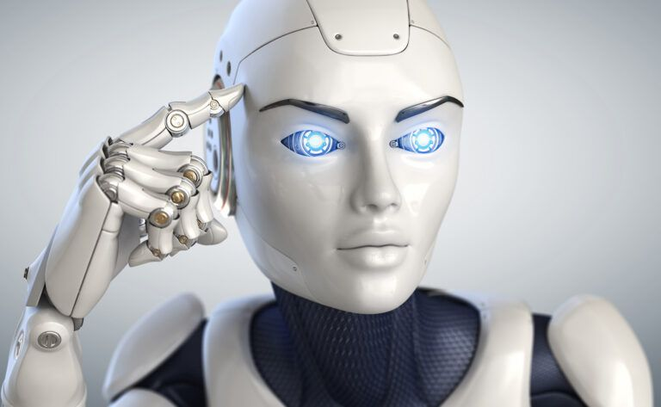
Background
Industry 4.0 and smart manufacturing
Digital twin technology:
Virtual representation of equipment
Real-time monitoring
Challenges in predictive maintenance:
Data integration and processing
Model accuracy

Slide 4

Problem Statement
Current limitations in maintenance:
Reactive or fixed schedules
Need for real-time failure prediction
Project goal:
Develop a digital twin-based predictive maintenance

Slide 5

Methodology
Approach:
Simulink Model: Simulate equipment data (vibration, temperature, pressure)
Data Processing: Prepare data for analysis
Machine Learning Model: Predict failures using decision tree
Dashboard: Real-time monitoring and alerts
Tools: MATLAB, Simulink, Machine Learning Toolbox

Slide 6

Experiments
Experiment setup:
Simulated data with normal and failure modes
Testing:
Train and test sets
Metrics: Accuracy, precision, recall
Objective: Evaluate model performance

Slide 7

Discussion
Key findings:
Accuracy: 43.33%
High false positives; detected 50% of actual failures
Limitations:
False alerts
Missed failure events
Proposed improvements:
Advanced algorithms (e.g., neural networks)
Additional data

Slide 8

Conclusion
Achievements:
Developed digital twin and predictive model
Real-time monitoring with dashboard
Objectives met: Predictive maintenance framework in place
Future work:
Real-world data integration
Enhanced algorithms
Improved dashboard features

Slide 9

Contribution of Team Members
Himanth Sai Jalagam:
Project coordination
Simulink model development
Data integration
Ram Charan Araja:
Literature review
Predictive model development
Performance evaluation
Durga Reddy Polimera:
Dashboard development
Data visualization
Testing and debugging

Slide 10

Q&A
Questions

Slide 11
Thank You

